Slide 1
Keyword Spotting Challenges/Constraints

Slide 2



What are we going to learn?
Collect and Preprocess Data
Design
and Train
Model
Evaluate, Optimize, Convert, Deploy
Make
Inferences
Micro
Challenges with Keyword Spotting
The Keyword Spotting ML Pipeline
Hands-on training of a Keyword Spotting Model
Notes:
Challenges = Cloud+Edge implications for Security, Privacy, Bandwidth, Battery, Latency, Datasets/Personalization -> how this leads to CONSTRAINTS
Bridge: https://thenounproject.com/term/challenge/2484190/
Diagram: by Dhilan (prof-owned)
Colab Logo: by Brian (prof-owned)

Slide 3

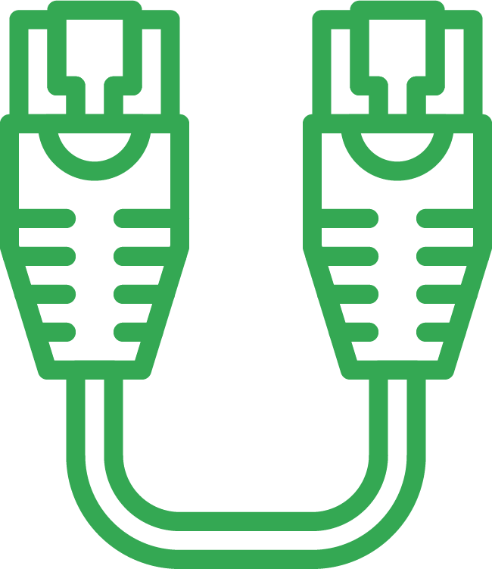










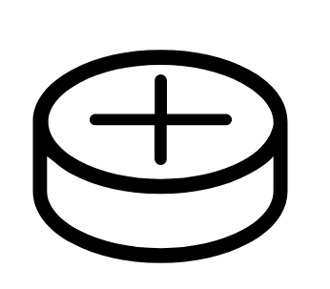
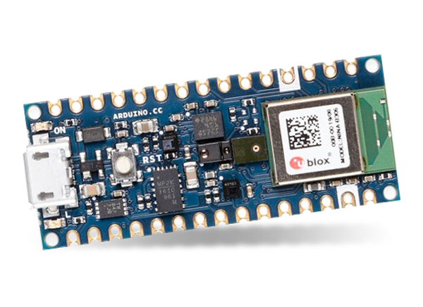
Challenges and Constraints
Latency & Bandwidth
Accuracy & Personalization
Latency & Bandwidth
Accuracy & Personalization
Security & Privacy
Battery & Memory
more ...
Security & Privacy
Battery & Memory
Notes:
This seems almost impossible so how do companies do keyword spotting today? Well it turns out the solution is to break the problem up and leverage both TinyML at the edge and the power of the cloud!
Stopwatch: https://thenounproject.com/search/?q=stopwatch&i=796219
Ethernet Cord: https://thenounproject.com/search/?q=ethernet&i=914487
Target: https://thenounproject.com/search/?q=target&i=158437
Browser: https://thenounproject.com/search/?q=personalize&i=1708912
Shield: https://thenounproject.com/search/?q=security&i=1281469
Eye: https://thenounproject.com/search/?q=privacy&i=230478
Battery: https://thenounproject.com/search/?q=coin+battery&i=221396
Memory: https://thenounproject.com/search/?q=processor&i=342918

Slide 4
Challenges and Constraints
Latency & Bandwidth
Accuracy & Personalization
Latency & Bandwidth
Accuracy & Personalization
Security & Privacy
Battery & Memory
more ...
LATENCY
Provide results quickly, respond in real-time to the user
Security & Privacy
Battery & Memory
Notes:
The first challenge / constraint is Latency: its not round trip query time to the cloud (but that matters too and is limited by bandwidth) its really the time from OK G to it responding that must be VERY fast

Slide 5
Challenges and Constraints
Latency & Bandwidth
Accuracy & Personalization
Latency & Bandwidth
Accuracy & Personalization
Security & Privacy
Battery & Memory
more ...
BANDWIDTH
Minimize data sent over the network (slow and expensive)
Security & Privacy
Battery & Memory
Notes:
The first challenge / constraint is Latency: its not round trip query time to the cloud (but that matters too and is limited by bandwidth) its really the time from OK G to it responding that must be VERY fast

Slide 6
Challenges and Constraints
Latency & Bandwidth
Accuracy & Personalization
Latency & Bandwidth
Accuracy & Personalization
Security & Privacy
Battery & Memory
more ...
ACCURACY
Listen continuously, but only trigger at the right time
Security & Privacy
Battery & Memory
Notes:
The first challenge / constraint is Latency: its not round trip query time to the cloud (but that matters too and is limited by bandwidth) its really the time from OK G to it responding that must be VERY fast

Slide 7
Challenges and Constraints
Latency & Bandwidth
Accuracy & Personalization
Latency & Bandwidth
Accuracy & Personalization
Security & Privacy
Battery & Memory
more ...
PERSONALIZATION
Trigger for the user and not for background noise
Security & Privacy
Battery & Memory
Notes:
The first challenge / constraint is Latency: its not round trip query time to the cloud (but that matters too and is limited by bandwidth) its really the time from OK G to it responding that must be VERY fast

Slide 8
Challenges and Constraints
Latency & Bandwidth
Accuracy & Personalization
Latency & Bandwidth
Accuracy & Personalization
Security & Privacy
Battery & Memory
more ...
SECURITY
Safeguarding the data that is being sent to the cloud
Security & Privacy
Battery & Memory
Notes:
Security/Privacy: employees listening to recordings to improve performance ethical issues

Slide 9
Challenges and Constraints
Latency & Bandwidth
Accuracy & Personalization
Latency & Bandwidth
Accuracy & Personalization
Security & Privacy
Battery & Memory
more ...
PRIVACY
Safeguarding the data that is being sent to the cloud
Security & Privacy
Battery & Memory
Notes:
Security/Privacy: employees listening to recordings to improve performance ethical issues

Slide 10
Challenges and Constraints
Latency & Bandwidth
Accuracy & Personalization
Latency & Bandwidth
Accuracy & Personalization
Security & Privacy
Battery & Memory
more ...
BATTERY
Limited energy, operate on coin-cell type batteries
Security & Privacy
Battery & Memory
Notes:
Security/Privacy: employees listening to recordings to improve performance ethical issues

Slide 11
Challenges and Constraints
Latency & Bandwidth
Accuracy & Personalization
Latency & Bandwidth
Accuracy & Personalization
Security & Privacy
Battery & Memory
more ...
MEMORY
Run on resource constrained devices
Security & Privacy
Battery & Memory
Notes:
Security/Privacy: employees listening to recordings to improve performance ethical issues

Slide 12
Challenges and Constraints
Latency & Bandwidth
Accuracy & Personalization
Latency & Bandwidth
Accuracy & Personalization
Security & Privacy
Battery & Memory
more ...
MORE
further
constraints
Security & Privacy
Battery & Memory
Notes:
More: If everyone used it all the time it would melt googles Data centers

Slide 13
Challenges and Constraints
Latency & Bandwidth
Accuracy & Personalization
Latency & Bandwidth
Accuracy & Personalization
Security & Privacy
Battery & Memory
more ...
So how do companies do Keyword Spotting today?
Security & Privacy
Battery & Memory
Notes:
More: If everyone used it all the time it would melt googles Data centers

Slide 14

Anatomy of a Keyword Spotting Application
1
Continuously listen on the microcontroller
Notes:
Arduino from earlier deck Mic: https://thenounproject.com/search/?q=microphone&i=953414

Slide 15
Anatomy of a Keyword Spotting Application
2
Process the data with TinyML at the edge
1
Continuously listen on the microcontroller
Notes:
Continuous recording and processed via tinyML on microntroller --- preserves security/privacy by keeping data and continuous recording on device and minimizes bandwith/latency by processing on device.

Slide 16

Anatomy of a Keyword Spotting Application
2
Process the data with TinyML at the edge
3
Send the data to the cloud when triggered
1
Continuously listen on the microcontroller
Notes:
When the word is found we “wake up the device” and send ONLY the complex command to the cloud -- this allows the on device model to stay small and efficient and not take up too much on device battery life and reduces the network communication of data which is bandwidth and battery inefficient.
CLOUD: https://thenounproject.com/search/?q=server&i=3596373

Slide 17
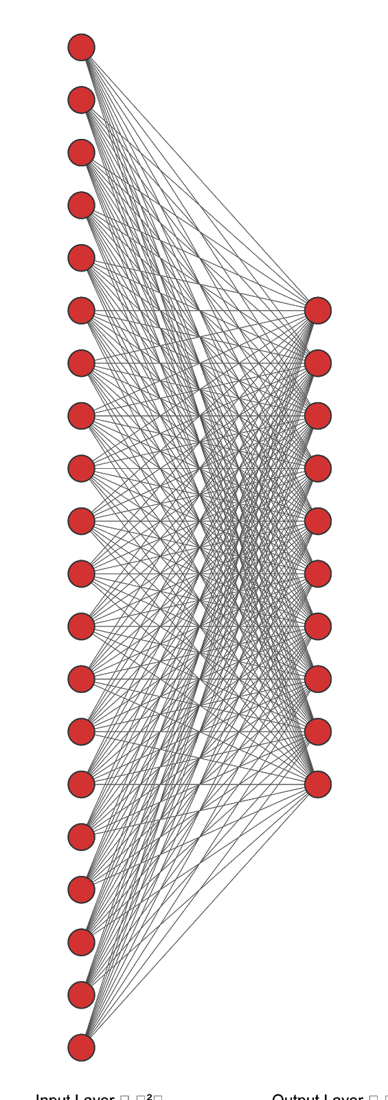
Anatomy of a Keyword Spotting Application
4
Process the full speech data with a large model in the cloud
2
Process the data with TinyML at the edge
3
Send the data to the cloud when triggered
1
Continuously listen on the microcontroller
Notes:
Then the cloud can efficiently process a LARGE COMPLEX model to figure out the complex command
This is a federated approach!
IMAGE NOTE: Large Network drawn in 2-3-2 (ours, I hope)

Slide 18

Anatomy of a Keyword Spotting Application
Notes:
Then the cloud can efficiently process a LARGE COMPLEX model to figure out the complex command
This is a federated approach!
IMAGE NOTE: Large Network drawn in 2-3-2 (ours, I hope)

Slide 19
Anatomy of a Keyword Spotting Application
Notes:
Then the cloud can efficiently process a LARGE COMPLEX model to figure out the complex command
This is a federated approach!
IMAGE NOTE: Large Network drawn in 2-3-2 (ours, I hope)

Slide 20
Anatomy of a Keyword Spotting Application
Notes:
Then the cloud can efficiently process a LARGE COMPLEX model to figure out the complex command
This is a federated approach!
IMAGE NOTE: Large Network drawn in 2-3-2 (ours, I hope)

Slide 21
How do we scale to billions of users?

Slide 22
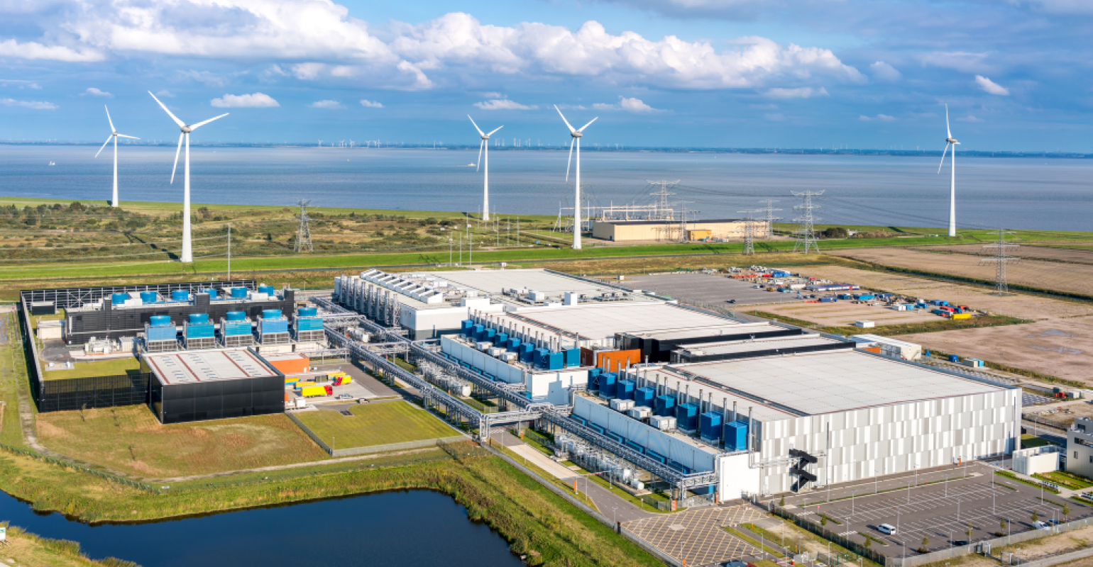
Source: Google
Notes:
https://www.google.com/about/datacenters/locations/eemshaven/
@Vijay: try to remain explicit--international growth, Netherlands, what is important about the international/European growth

Slide 23
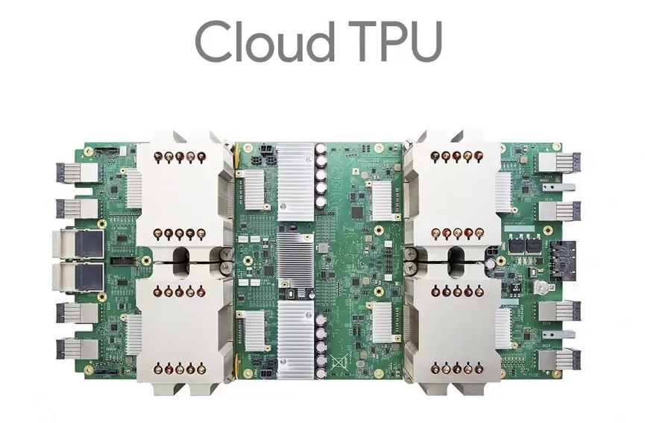
Source: Google
Notes:
Hook visual aspect of the image--something we can see in the chip
Fair use won’t cover decorative/illustrative purposes--

Slide 24
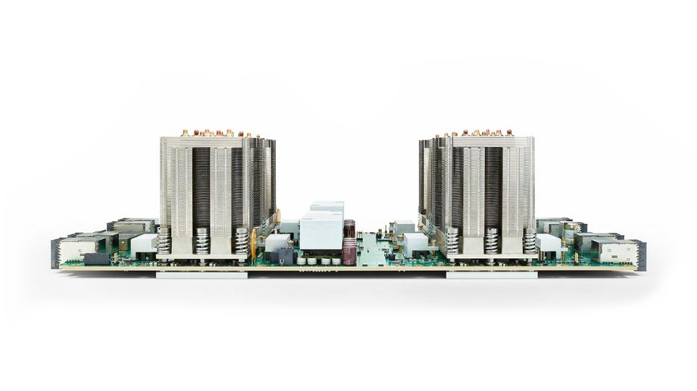
300 Watts
Source: Google
Notes:
Image: https://moorinsightsstrategy.com/google-cloud-tpu-strategic-implications-for-google-nvidia-and-the-machine-learning-industry/
Fair use: @vijay please directly address image (e.g., large heatsinks)

Slide 25
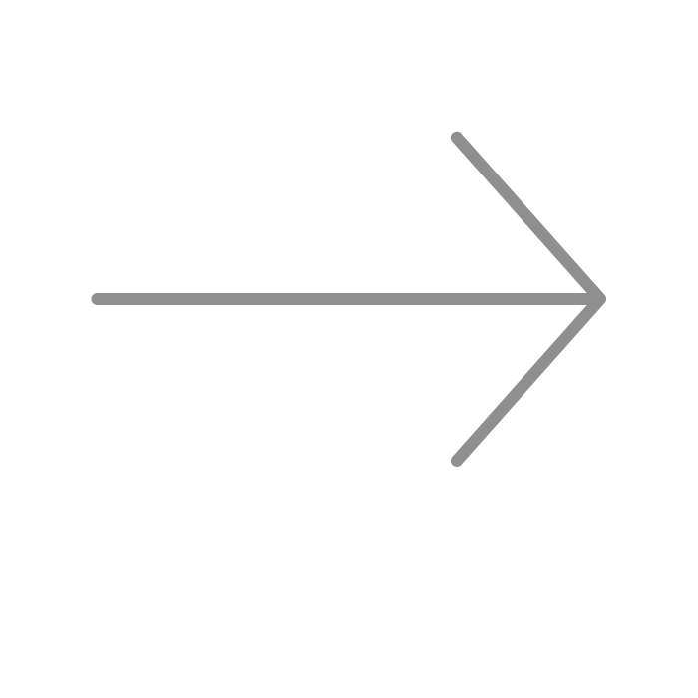
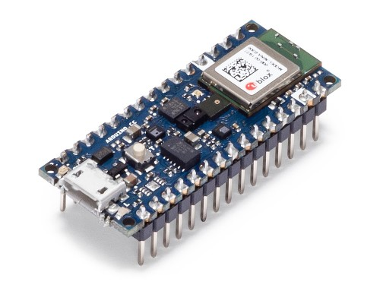
300 Watts
< 1 mWatt
Cloud TPU
TinyML

Slide 26

Anatomy of a Keyword Spotting Application
Notes:
Keyword spotting acts as a filter--not everything has to hit the datacenter. Entire infrastructure in place to get the right data up to the cloud.
IMAGE NOTE: Large Network drawn in 2-3-2 (ours, I hope)
Filter: https://thenounproject.com/search/?q=filter&i=3607626

Slide 27
Notes:
How did this match up with the challenges and constraints you put in the forum? I bet you got most of them and I hope you learned a new one! Before we move onto how we can use tinyML to spot the keywords we are going to do a short reading to reinforce the serious privacy adn security implications of these kinds of always on systems!

Slide 28

Latency
Provide results quickly, respond in real-time to the user
Notes:
The first challenge / constraint is Latency: its not round trip query time to the cloud (but that matters too and is limited by bandwidth) its really the time from OK G to it responding that must be VERY fast

Slide 29
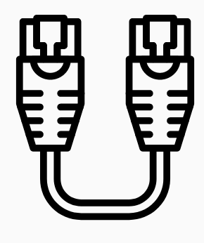
Bandwidth
Minimize data sent over the network (slow and expensive)
Notes:
The first challenge / constraint is Latency: its not round trip query time to the cloud (but that matters too and is limited by bandwidth) its really the time from OK G to it responding that must be VERY fast

Slide 30

Accuracy
Listen continuously, but only trigger at the right time
Notes:
The first challenge / constraint is Latency: its not round trip query time to the cloud (but that matters too and is limited by bandwidth) its really the time from OK G to it responding that must be VERY fast

Slide 31
Personalization
Trigger for the user and not for background noise
Notes:
The first challenge / constraint is Latency: its not round trip query time to the cloud (but that matters too and is limited by bandwidth) its really the time from OK G to it responding that must be VERY fast

Slide 32
Security
Safeguarding the data that is being sent to the cloud
Notes:
Security/Privacy: employees listening to recordings to improve performance ethical issues

Slide 33
Privacy
Safeguarding the data that is being sent to the cloud
Notes:
Security/Privacy: employees listening to recordings to improve performance ethical issues

Slide 34
Memory
Our board (in your kit for Course 3) only has 256KB of RAM (memory)
Run on resource constrained devices
Notes:
Security/Privacy: employees listening to recordings to improve performance ethical issues

Slide 35
Battery
Limited energy
No wall power
Operate on coin cell type batteries
Notes:
Security/Privacy: employees listening to recordings to improve performance ethical issues

Slide 36
Challenges / Constraints
Latency, Bandwidth,
Accuracy, Personalization,
Security, Privacy,
Memory, Battery,
And many more...
Notes:
More: If everyone used it all the time it would melt googles Data centers

Slide 37
Challenges / Constraints
So how do companies do Keyword Spotting today?
Latency & Bandwidth
Accuracy & Personalization
Security/Privacy
Battery & Memory
And many more...
Notes:
This seems almost impossible so how do companies do keyword spotting today? Well it turns out the solution is to break the problem up and leverage both TinyML at the edge and the power of the cloud!

Slide 38

Anatomy of a Keyword Spotting Application
2
Process the data with tinyML at the edge
3
Send the data to the cloud when triggered
1
Continuously listen on the microcontroller
Notes:
When the word is found we “wake up the device” and send ONLY the complex command to the cloud -- this allows the on device model to stay small and efficient and not take up too much on device battery life and reduces the network communicaiton of data which is bandwidth and battery inefficient.

Slide 39
Anatomy of a Keyword Spotting Application
2
Process the data with tinyML at the edge
4
Process the full speech data with a large model in the cloud
3
Send the data to the cloud when triggered
1
Continuously listen on the microcontroller
Notes:
THen the cloud can efficiently process a LARGE COMPLEX model to figure out the complex command
This is a federated approach!

Slide 40
Anatomy of a Keyword Spotting Application
2
Process the data with tinyML at the edge
4
Process the full speech data with a large model in the cloud
3
Send the data to the cloud when triggered
1
Continuously listen on the microcontroller
Notes:
THen the cloud can efficiently process a LARGE COMPLEX model to figure out the complex command
This is a federated approach!
https://thenounproject.com/search/?q=microphone&i=3590686

Slide 41
Anatomy of a Keyword Spotting Application
Notes:
THen the cloud can efficiently process a LARGE COMPLEX model to figure out the complex command
This is a federated approach!
https://thenounproject.com/search/?q=microphone&i=3590686

Slide 42
Anatomy of a Keyword Spotting Application
Notes:
THen the cloud can efficiently process a LARGE COMPLEX model to figure out the complex command
This is a federated approach!

Slide 43
Anatomy of a Keyword Spotting Application
Notes:
THen the cloud can efficiently process a LARGE COMPLEX model to figure out the complex command
This is a federated approach!
https://thenounproject.com/search/?q=microphone&i=3590686

Slide 44
Anatomy of a Keyword Spotting Application
How do we scale to billions of users?
Notes:
THen the cloud can efficiently process a LARGE COMPLEX model to figure out the complex command
This is a federated approach!
https://thenounproject.com/search/?q=microphone&i=3590686

Slide 45

Anatomy of a Keyword Spotting Application
Notes:
THen the cloud can efficiently process a LARGE COMPLEX model to figure out the complex command
This is a federated approach!
https://thenounproject.com/search/?q=microphone&i=3590686

